Slide 1
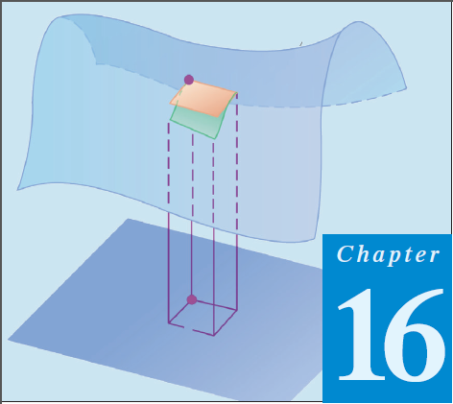
13
Thomas Calculus 12th (Chapter 16)
Calculus 9rd, Dale Varberg, Edwin Purcell and Steve Rigdon (C.14)
Divergence Theorem
Samuel Lukas

Slide 2
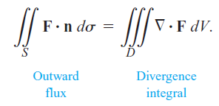
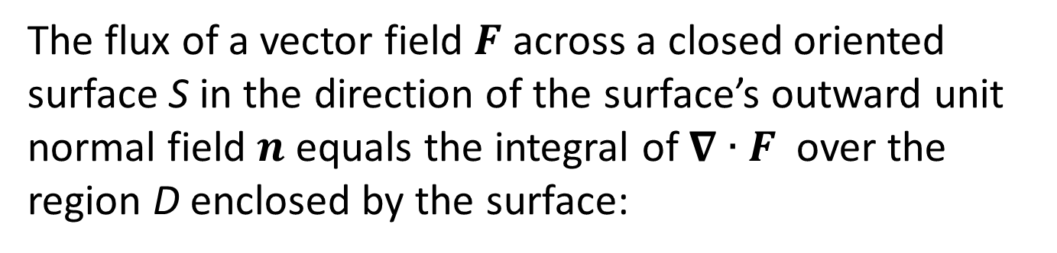
Divergence Theorem
The flux of a vector field $F$ across a closed oriented surface S in the direction of the surface’s outward unit normal field $n$ equals the integral of $∇∙F$over the region D enclosed by the surface:

Slide 3






Example 1

Slide 4


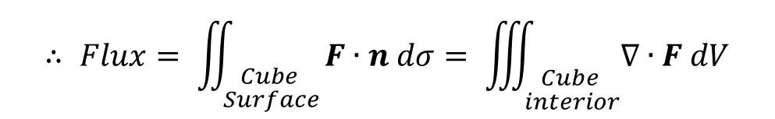
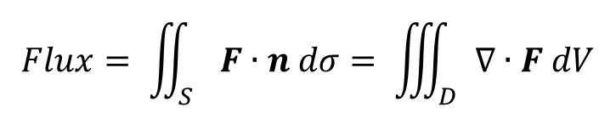
$$Flux= \iint_{S}{F∙n dσ= \iiint_{D}{∇∙F dV}}$$
$$∴ Flux= \iint_{\begin{aligned}Cube \\ Surface\end{aligned}}{F∙n dσ= \iiint_{\begin{aligned}Cube \\ interior\end{aligned}}{∇∙F dV}}$$

Slide 5
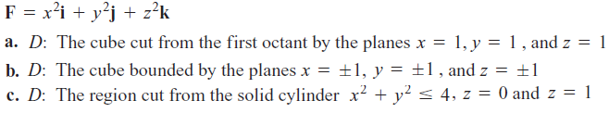

Exercises 1
In Exercises 1 – 12, use the Divergence Theorem to find the outward flux of F across the boundary of the region D.
1.
2.
3.

Slide 6




4.
5.
6.
7.
8.

Slide 7




09.
10.
11.
12.

